Slide 1

Boosting Algorithm – LGBoost_Regression
Presented by Rousan

Slide 2

Delivering with confidence
LightGBM Regression
LightGBM Regressor (specifically LGBMRegressor in Python) is a highly efficient machine learning model used to predict continuous numerical values, such as housing prices, stock values, or physical measurements. It is part of the LightGBM framework (Light Gradient Boosting Machine) developed by Microsoft, which builds an ensemble of decision trees sequentially to correct the errors of previous tre

Slide 3
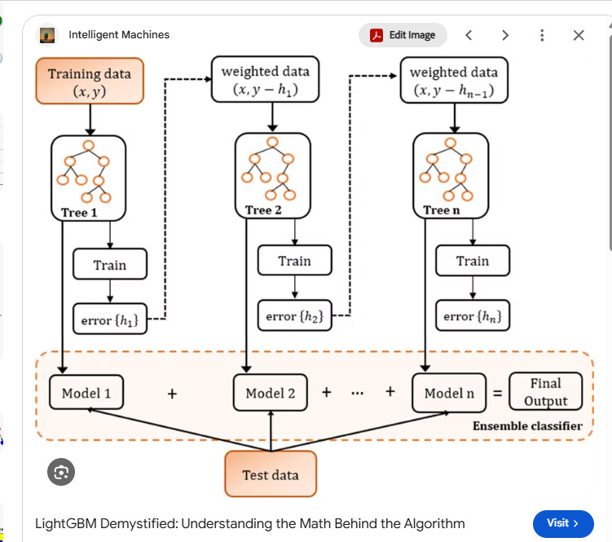

Slide 4
LightGBM Regressor — Key Parameters and Their Purpose
Parameter(s) | Purpose
num_leaves / max_depth | Control the complexity of leaf-wise trees by limiting the number of leaves and tree depth.
min_child_samples | Sets the minimum number of observations required in a leaf. Particularly important for small datasets.
n_estimators / learning_rate | Control the number of boosting rounds and the size of each correction. Tune them together.
subsample / subsample_freq | Control row sampling. Set subsample < 1.0 and subsample_freq > 0 to enable it.
colsample_bytree / reg_lambda | Control feature sampling per tree and L2 regularization on leaf weights, respectively.

Slide 5
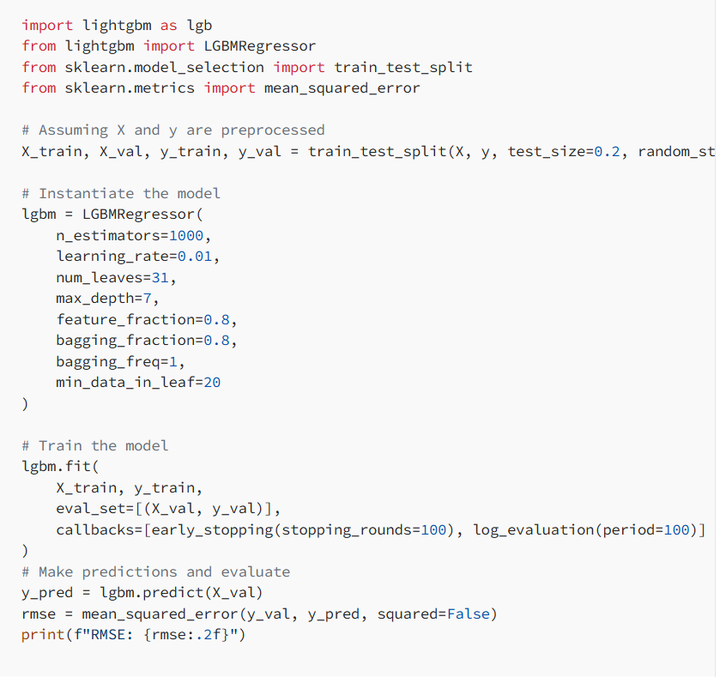
Python Code

Slide 6

How LightGBM Regression Works
LightGBM Regressor is a highly efficient machine learning model that predicts continuous numerical values by sequentially building an ensemble of decision trees. Developed by Microsoft, it belongs to the Gradient Boosting Decision Tree (GBDT) framework. Instead of building a single complex model, it creates a series of weak decision trees where each new tree is trained to correct the errors (residuals) made by the previous tree

Slide 7

Key Characteristics
Leaf-Wise Tree Growth: Instead of growing trees level-by-level (depth-wise) like traditional algorithms, LightGBM uses a leaf-wise strategy that splits the leaf with the highest loss reduction. This builds deeper, more expressive trees faster, though it requires setting max_depth or num_leaves to prevent overfitting on small datasets
Histogram-Based Splitting: Continuous numerical features are bucketed into discrete bins (histograms) instead of evaluating every single data point value. This dramatically reduces memory usage and speeds up training calculations
Gradient-Based One-Side Sampling (GOSS): GOSS keeps all data points with large gradients (the ones with large errors needing more training) and randomly samples data points with small gradients. This cuts down the dataset size while maintaining accuracy for the regression objective. [1, 2]
Exclusive Feature Bundling (EFB): EFB combines mutually exclusive features (features that rarely take non-zero values at the same time, like one-hot encoded variables) into a single feature. This reduces dimensionality without losing information, making the algorithm run faste
Regression Objectives: For regression tasks, it typically optimizes for L2 loss (Mean Squared Error) or L1 loss (Mean Absolute Error) to minimize prediction errors across numerical targets

